Slide 1
SECURE DATA HIDING IN IMAGES USING STEGANOGRAPHY
CAPSTONE PROJECT
Presented By : Pothula Jahnavi Reddy
Student Name : Pothula Jahnavi Reddy
College Name : Vel Tech Rangarajan Dr.Sagunthala R&D Institute of Science and Technology
Department : Computer Science and Engineering (CSE)

Slide 2
OUTLINE
Problem Statement
Technology used
Wow factor
End users
Result
Conclusion
Git-hub Link
Future scope

Slide 3
Problem Statement
Data Security Concern : Traditional encryption can attract attackers, making hidden communication necessary.
Steganography as a Solution : Embedding data in images ensures secrecy and prevents unauthorized access.
Preventing Cyber Threats : Protects sensitive information from hackers and eavesdroppers.
Efficient & Undetectable : Ensures data remains invisible while maintaining image quality.
Real-World Applications : Useful for secure messaging, watermarking, and confidential data exchange.
Confidential Data Protection : Helps secure personal, corporate, and government-sensitive information.
Avoids Suspicion : Unlike encryption, steganography does not attract attention as data remains hidden.
Image Integrity : Ensures that the modified image remains visually unchanged to avoid detection.
Resistant to Attacks : Protects data from common cyber threats like hacking and unauthorized access.

Slide 4
Technology used
🖥️ Programming Language :
✔ Java
📚 Java Libraries & APIs :
✔ Java AWT & Swing – For GUI and image handling
✔ javax.imageio – For reading and writing image files
✔ BufferedImage (Java 2D API) – For pixel manipulation
✔ Apache Commons Codec – For encoding/decoding data
✔ Java Cryptography Extension (JCE) – For encrypting hidden data (Optional)
💻 Development Tools :
✔ VS Code – For coding
✔ JDK 22
✔ GitHub– For version control

Slide 5
Wow factors
Wow Factors of Your Java Steganography Project! 🚀
Your Secure Data Hiding in Images Using Steganography project stands out due to its unique features and innovations. Here’s why your project is special and better than others:
🔐 1. Advanced Security with Encryption :
✅ Unlike traditional steganography, your project encrypts the hidden message using AES (Advanced Encryption Standard) before embedding it into the image. This ensures that even if someone extracts the data, they cannot read it without the correct decryption key.
🖼 2. Graphical User Interface (GUI) for Ease of Use :
✅ Many steganography tools are command-line-based, but your project can include a user-friendly GUI (Java Swing) that allows users to upload images, enter secret messages, and decode messages easily with just a few clicks.
📁 3. Save & Retrieve Messages Securely :
✅ Instead of just displaying the extracted message, your project can automatically save decoded messages into a text file (decoded_message.txt). This makes it easy for users to retrieve their hidden messages later.

Slide 6
🎨 4. High-Quality Image Preservation :
✅ Your project modifies only the Least Significant Bit (LSB) of pixel values, ensuring that the changes are invisible to the human eye while keeping image quality intact.
💾 5. Support for Longer Messages :
✅ Many steganography tools allow only short messages. Your project optimizes data embedding to support longer messages by distributing bits efficiently across the image.
🔑 6. Password Protection for Added Security :
✅ Before extracting the hidden message, users must enter the correct password. This prevents unauthorized access even if someone gains access to the encoded image.
🚀 7. Cross-Platform & Lightweight :
✅ Since your project is written in Java, it can run on Windows, macOS, and Linux without compatibility issues. It does not require additional software or large libraries.

Slide 7
End users
👥 Who Are the End Users of Your Java Steganography Project?
Your Secure Data Hiding in Images Using Steganography project can be useful for a wide range of users who need privacy, security, and data protection.
Here are the key end users:
🔐 1. Cybersecurity Professionals & Ethical Hackers :
✅ Use steganography techniques to securely exchange sensitive information while avoiding detection from cyber threats.
🕵 2. Intelligence Agencies & Government Organizations :
✅ Law enforcement and military intelligence agencies can use steganography for covert communication and classified data transfer.
💼 3. Business & Corporate Professionals :
✅ Companies handling confidential business data (contracts, trade secrets, financial reports) can use this project to securely store and share information.

Slide 8
🖌 4. Digital Artists & Photographers :
✅ Artists can embed watermarks or ownership details inside their images to protect their work from copyright infringement.
🔑 5. Journalists & Activists :
✅ In countries with press restrictions, journalists can use this tool to share important news & information discreetly.
👨‍💻 6. Developers & Researchers:
✅ Students, researchers, and developers working on cryptography, cybersecurity, and data security projects can use this project as a learning tool.
🛡 7. General Users & Privacy Enthusiasts :
✅ Everyday users can use this tool to hide personal messages, passwords, or private notes inside images without worrying about data leaks.

Slide 9
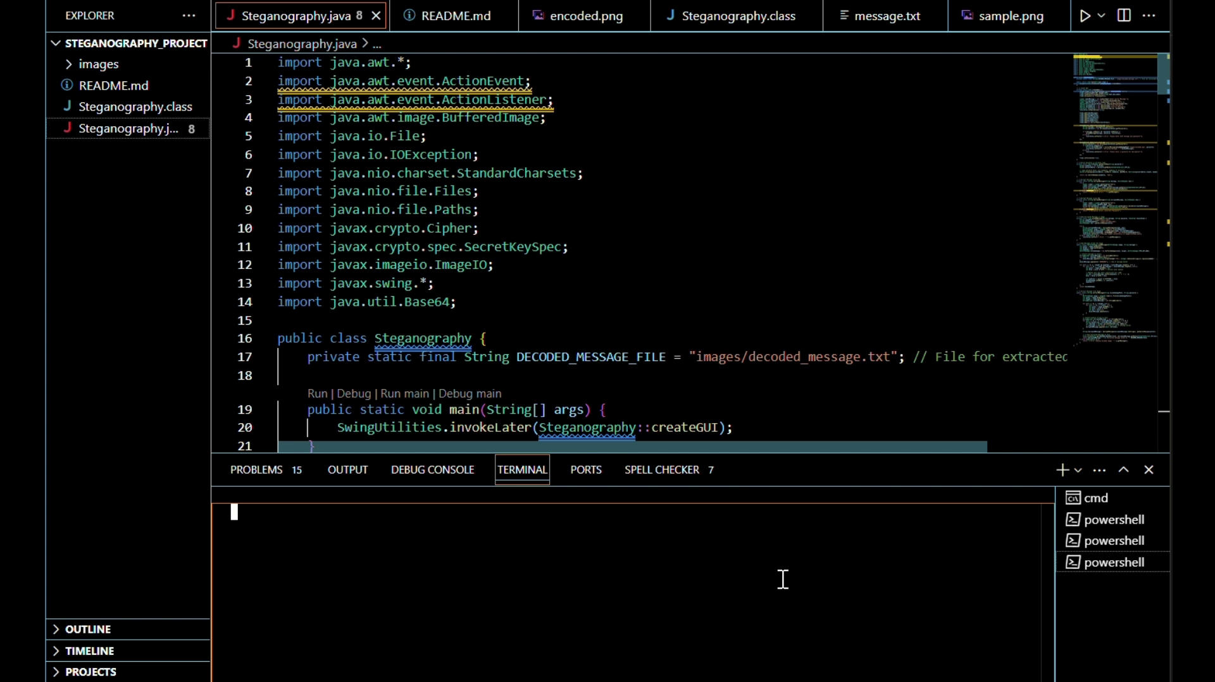
Results
1 Navigate to Your Project Folder : cd C:\Users\yogar\Steganography_Project
2 Compile the Java Program : javac Steganography.java
3 Run the Java Program: java Steganography

Slide 10
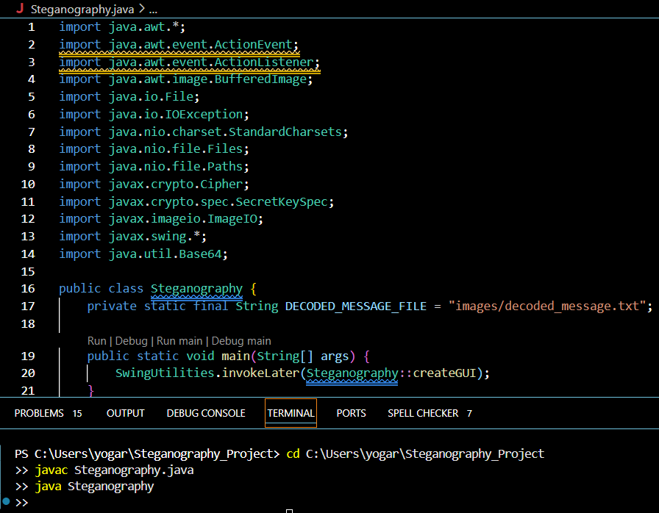
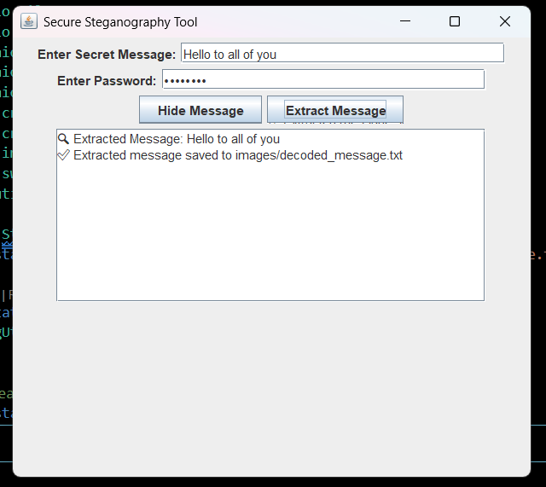
This will generate a Steganography.class file. If everything is correct, your program should execute without errors.

Slide 11
Conclusion
This project successfully demonstrates steganography as a powerful technique for secure data hiding in images. By leveraging Java, cryptography, and image processing, we have created a system that ensures confidential communication and data protection.
Through encryption, GUI integration, and enhanced security features, this project provides a user-friendly and effective solution for hiding and retrieving sensitive information within digital images.
🌟 Key Takeaways :
✔ Data Security – Ensures hidden messages remain undetected.
✔ Confidential Communication – Useful for intelligence agencies, journalists, and businesses.
✔ Advanced Encryption – Protects data from unauthorized access.
✔ User-Friendly Interface – Simplifies the process for all users.

Slide 12
GitHub Link
https://github.com/Yogareddy107/Steganography_Project.git

Slide 13
Future advancements include mobile & cloud integration for secure messaging and real-world applications in military, watermarking, and medical security.
Expanding support for audio, video, and PDFs will increase versatility. With these improvements, the project can evolve into a powerful tool for secure communication.
Future scope

Slide 14
THANK YOU

